Slide 1
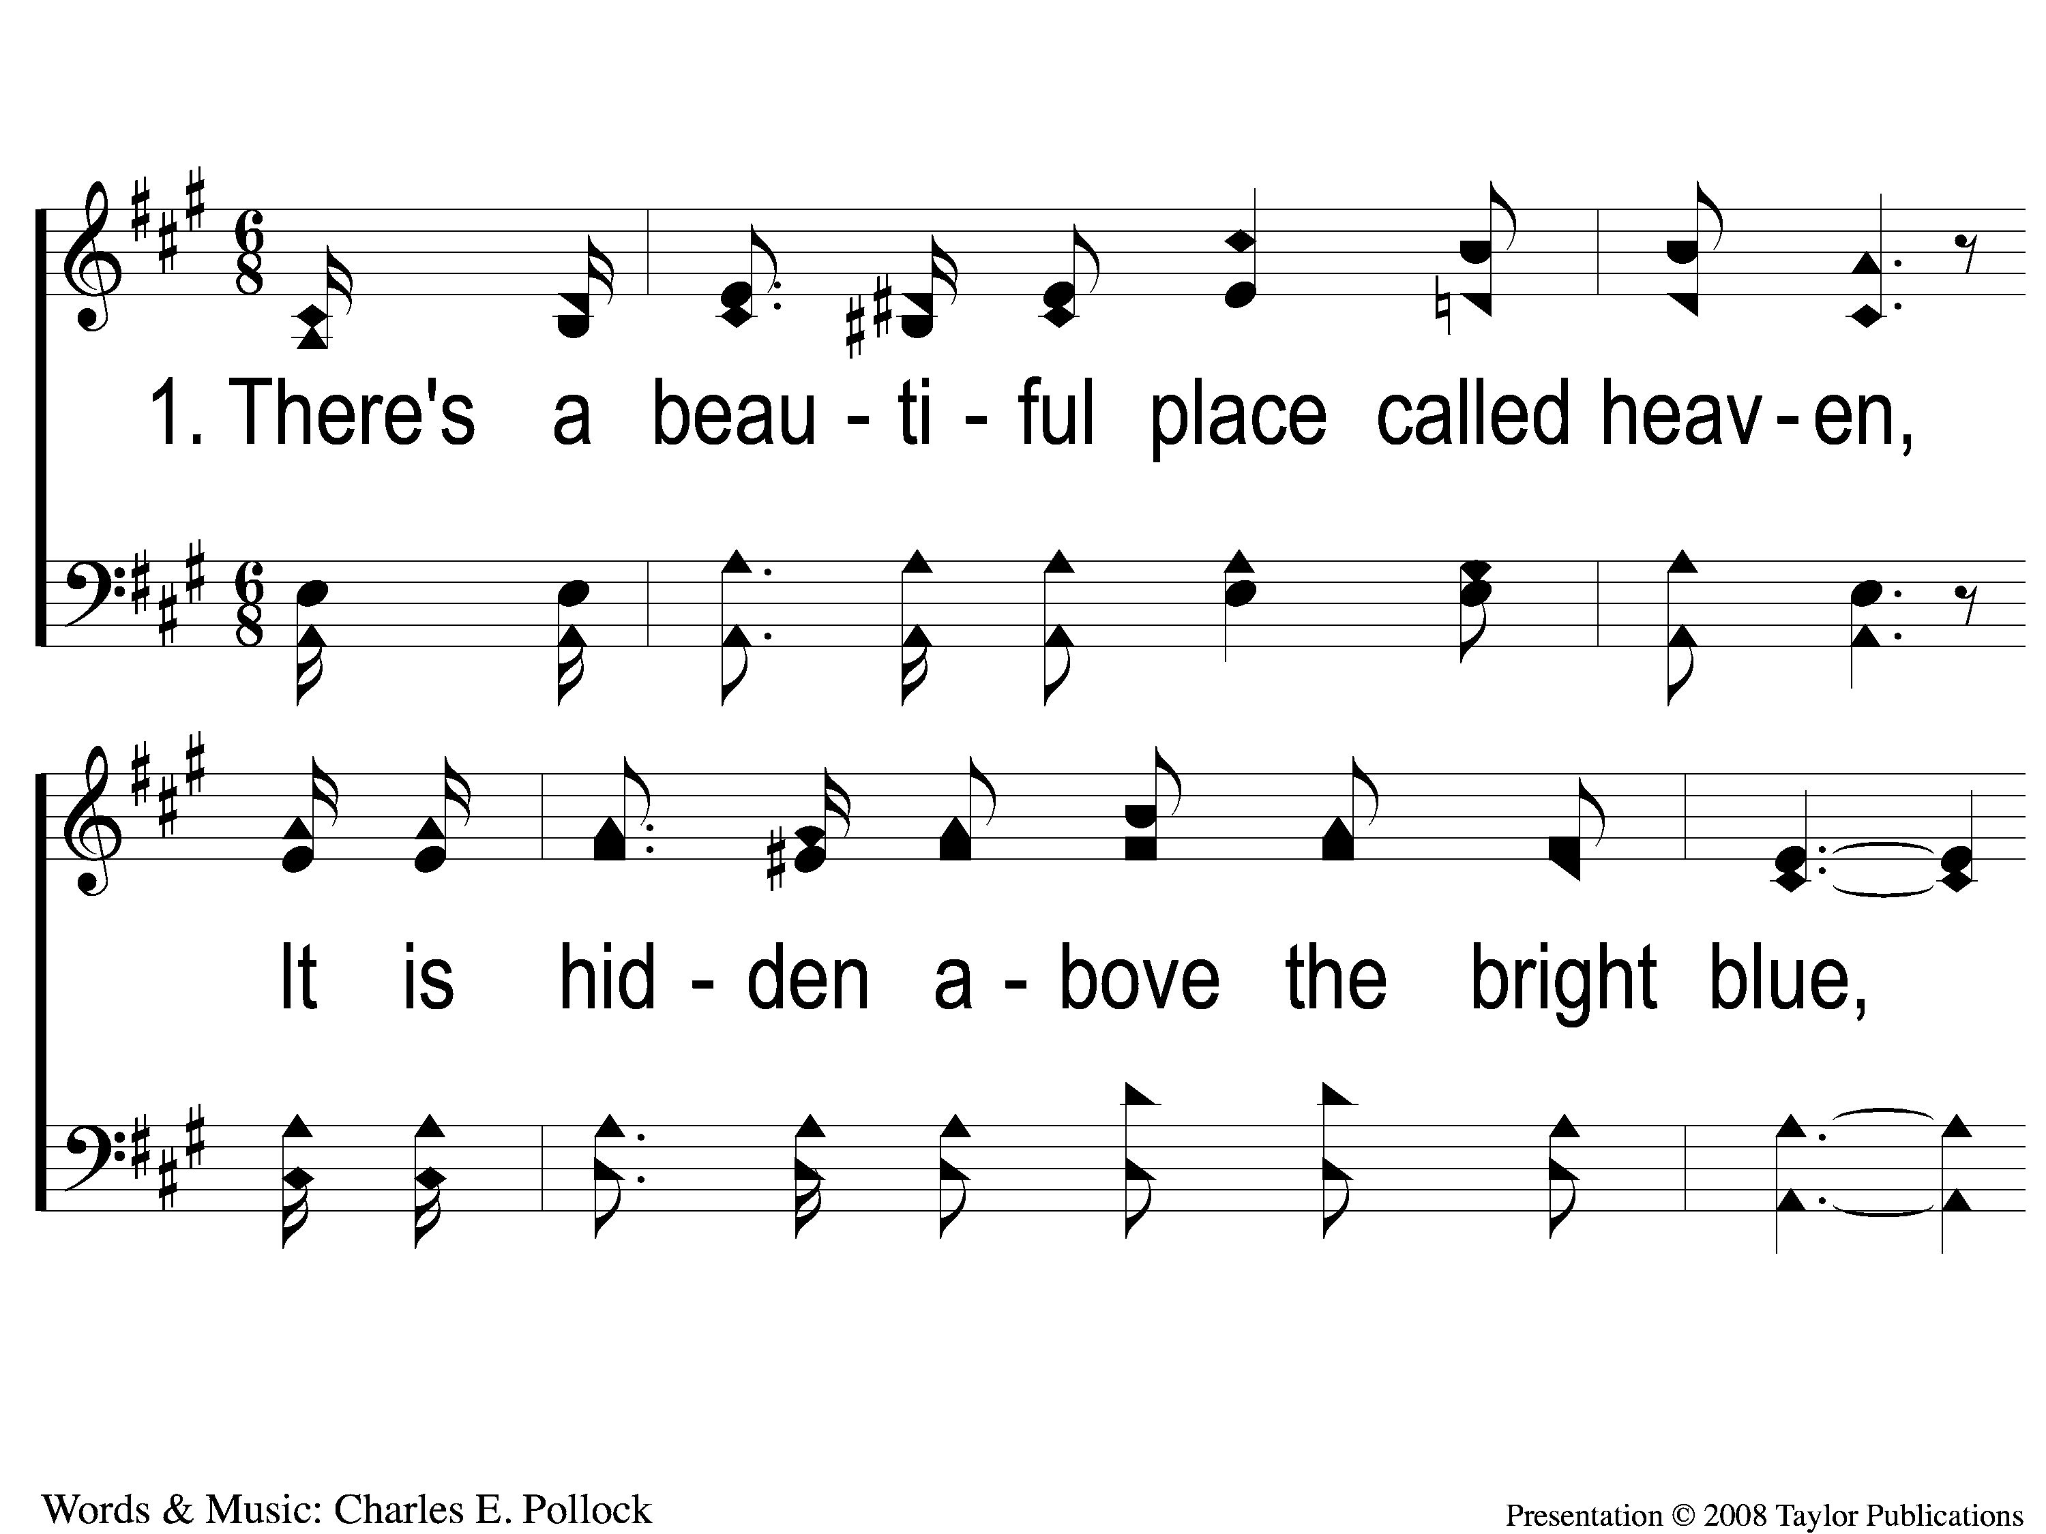
1-1 Above the Bright Blue
Above the Bright Blue
17

Slide 2
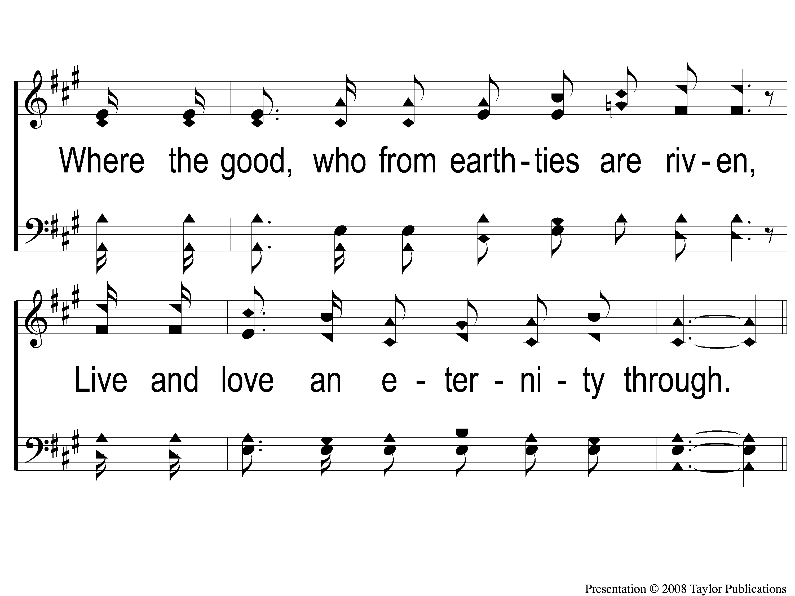
1-2 Above the Bright Blue
Above the Bright Blue
17

Slide 3
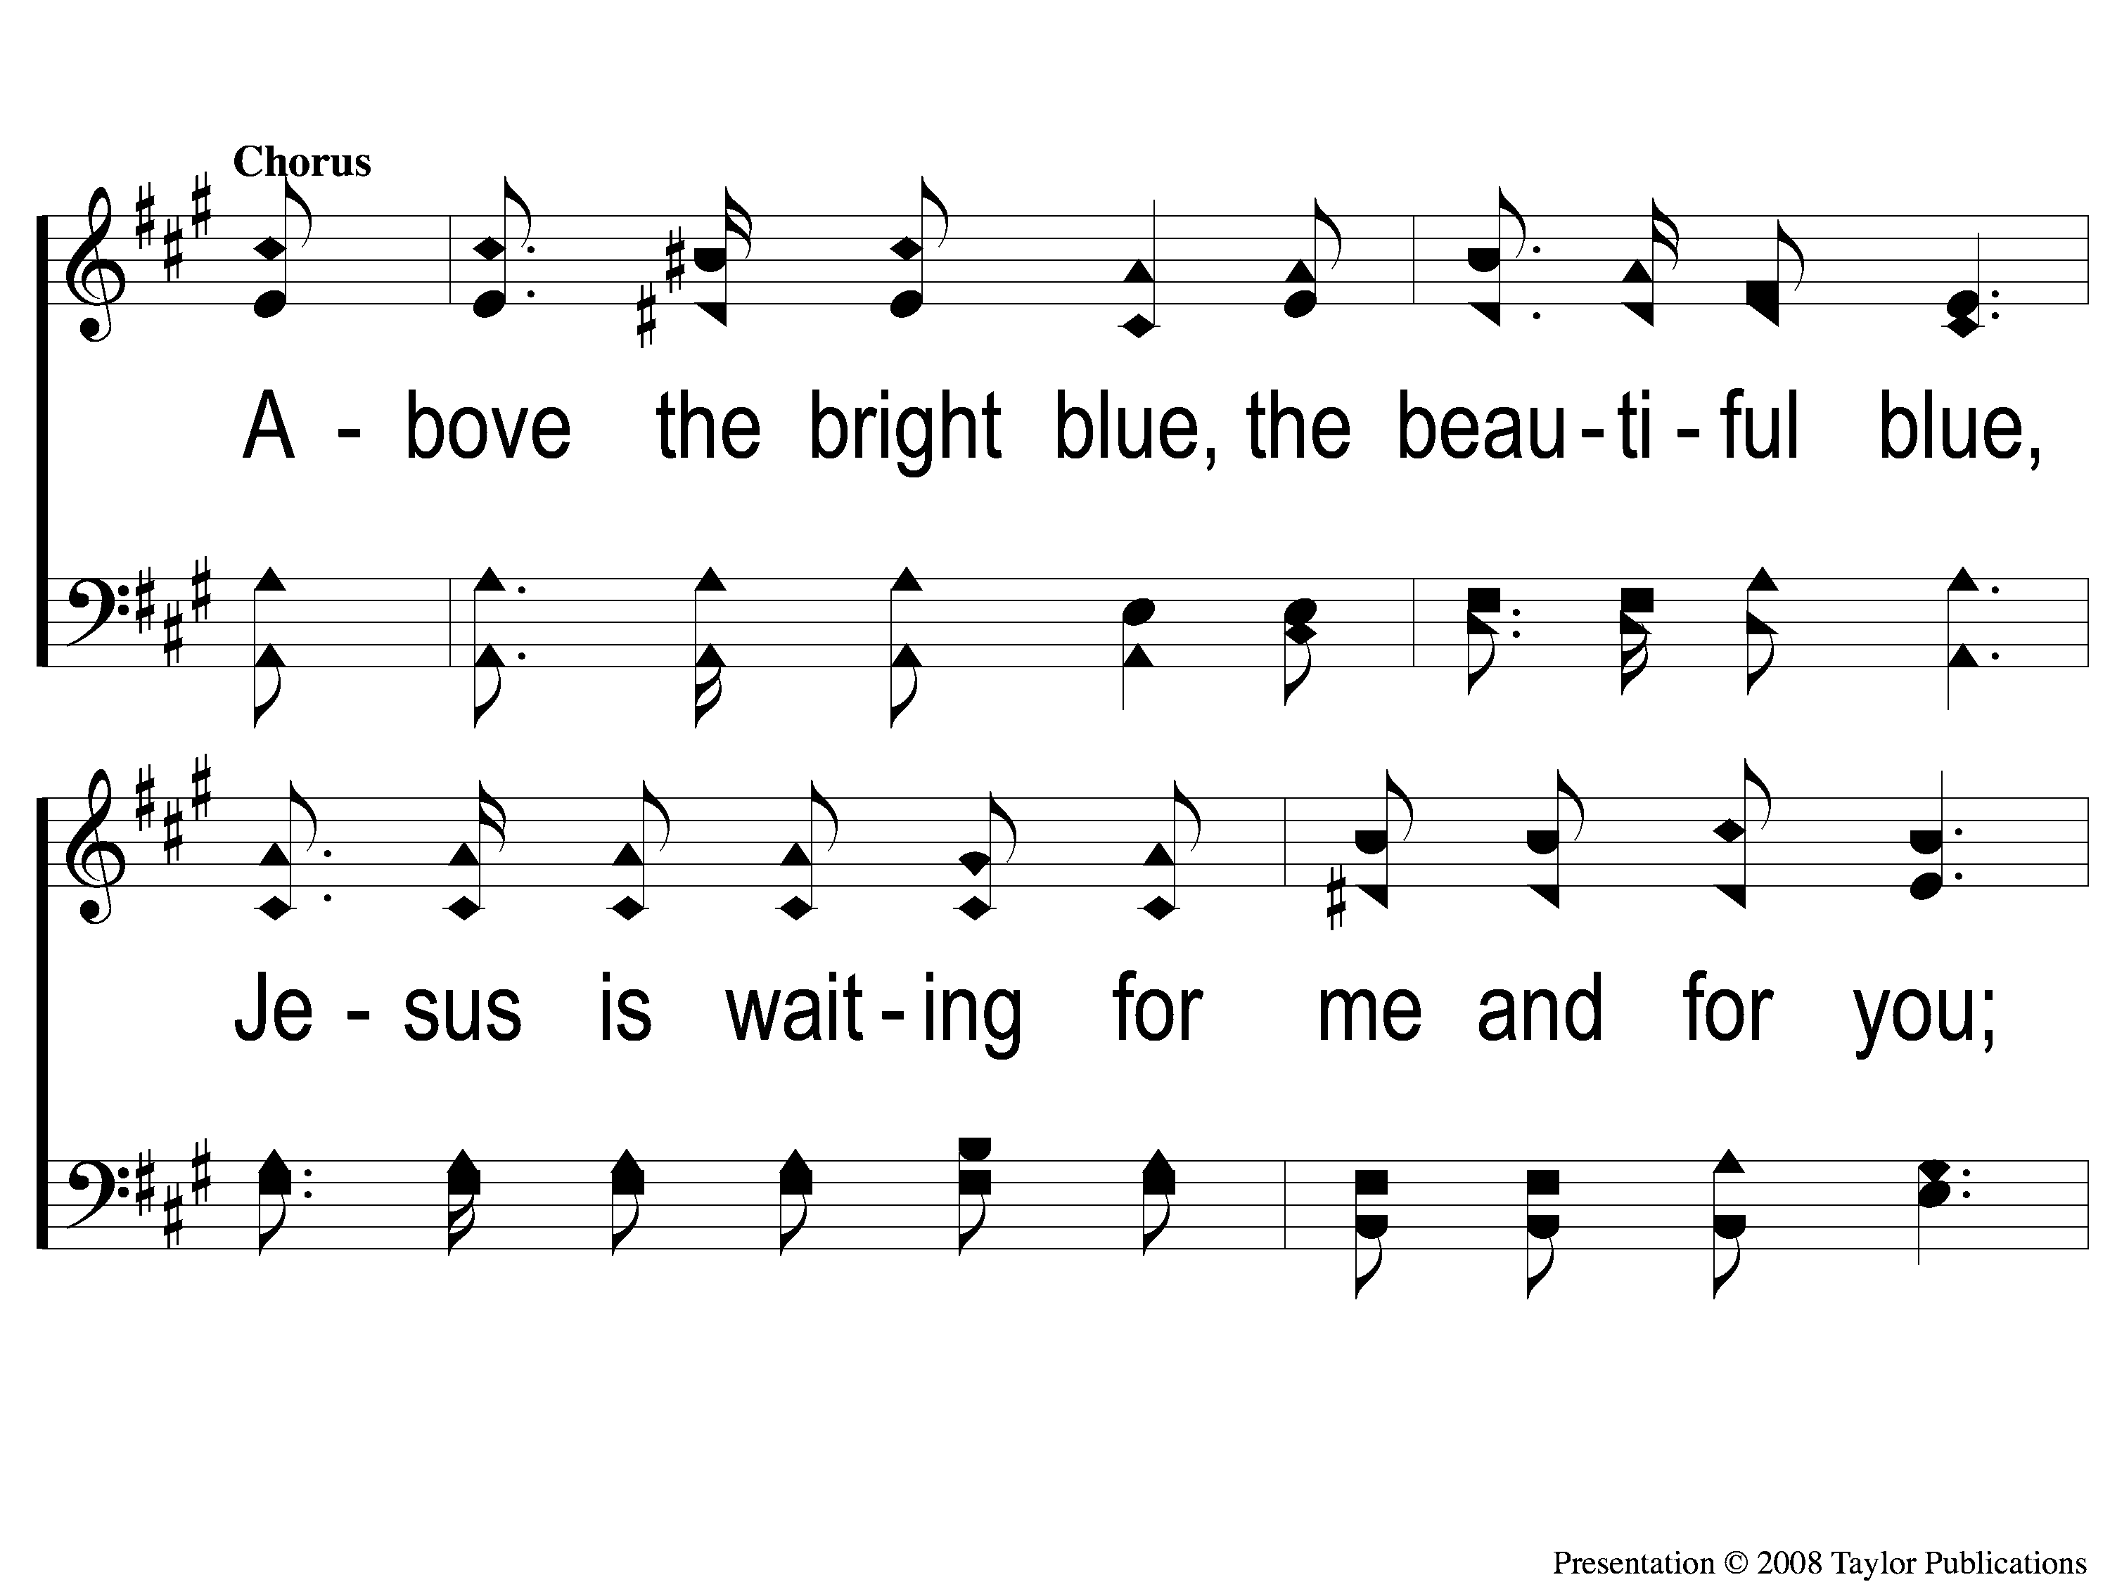
C-1 Above the Bright Blue
Above the Bright Blue
17

Slide 4
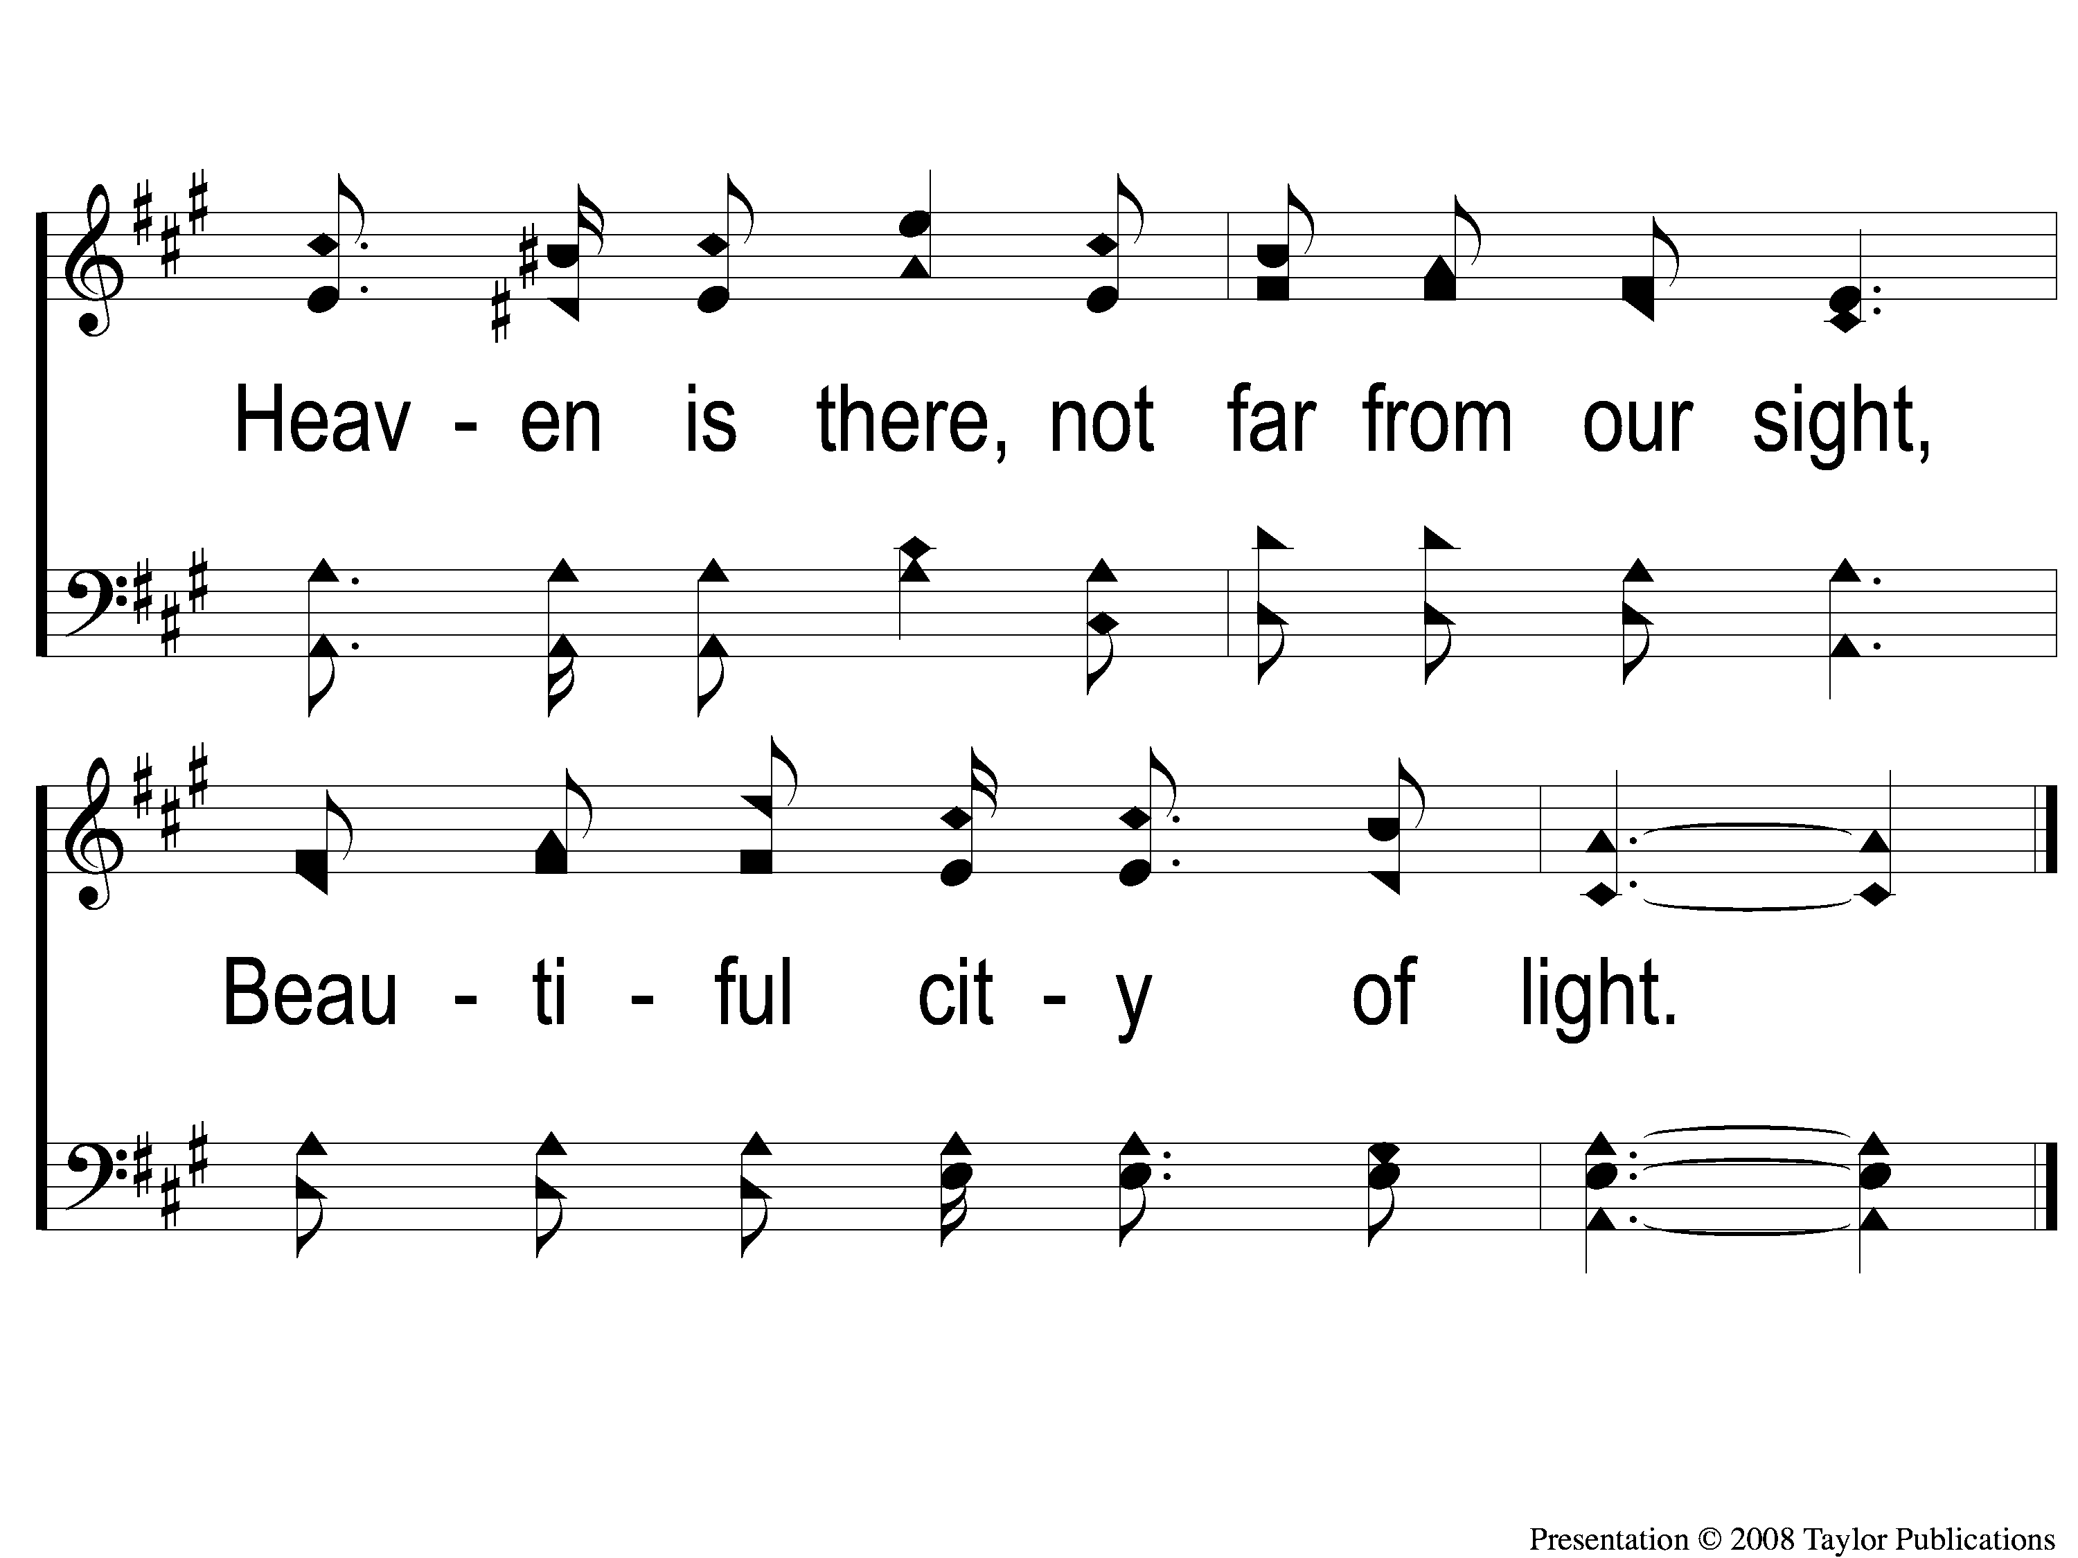
C-2 Above the Bright Blue
Above the Bright Blue
17

Slide 5
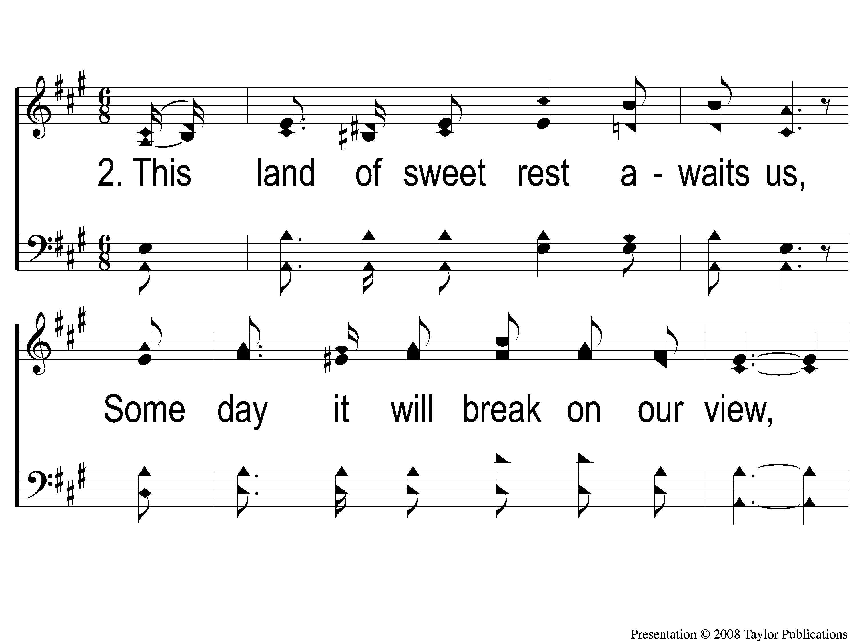
2-1 Above the Bright Blue
Above the Bright Blue
17

Slide 6
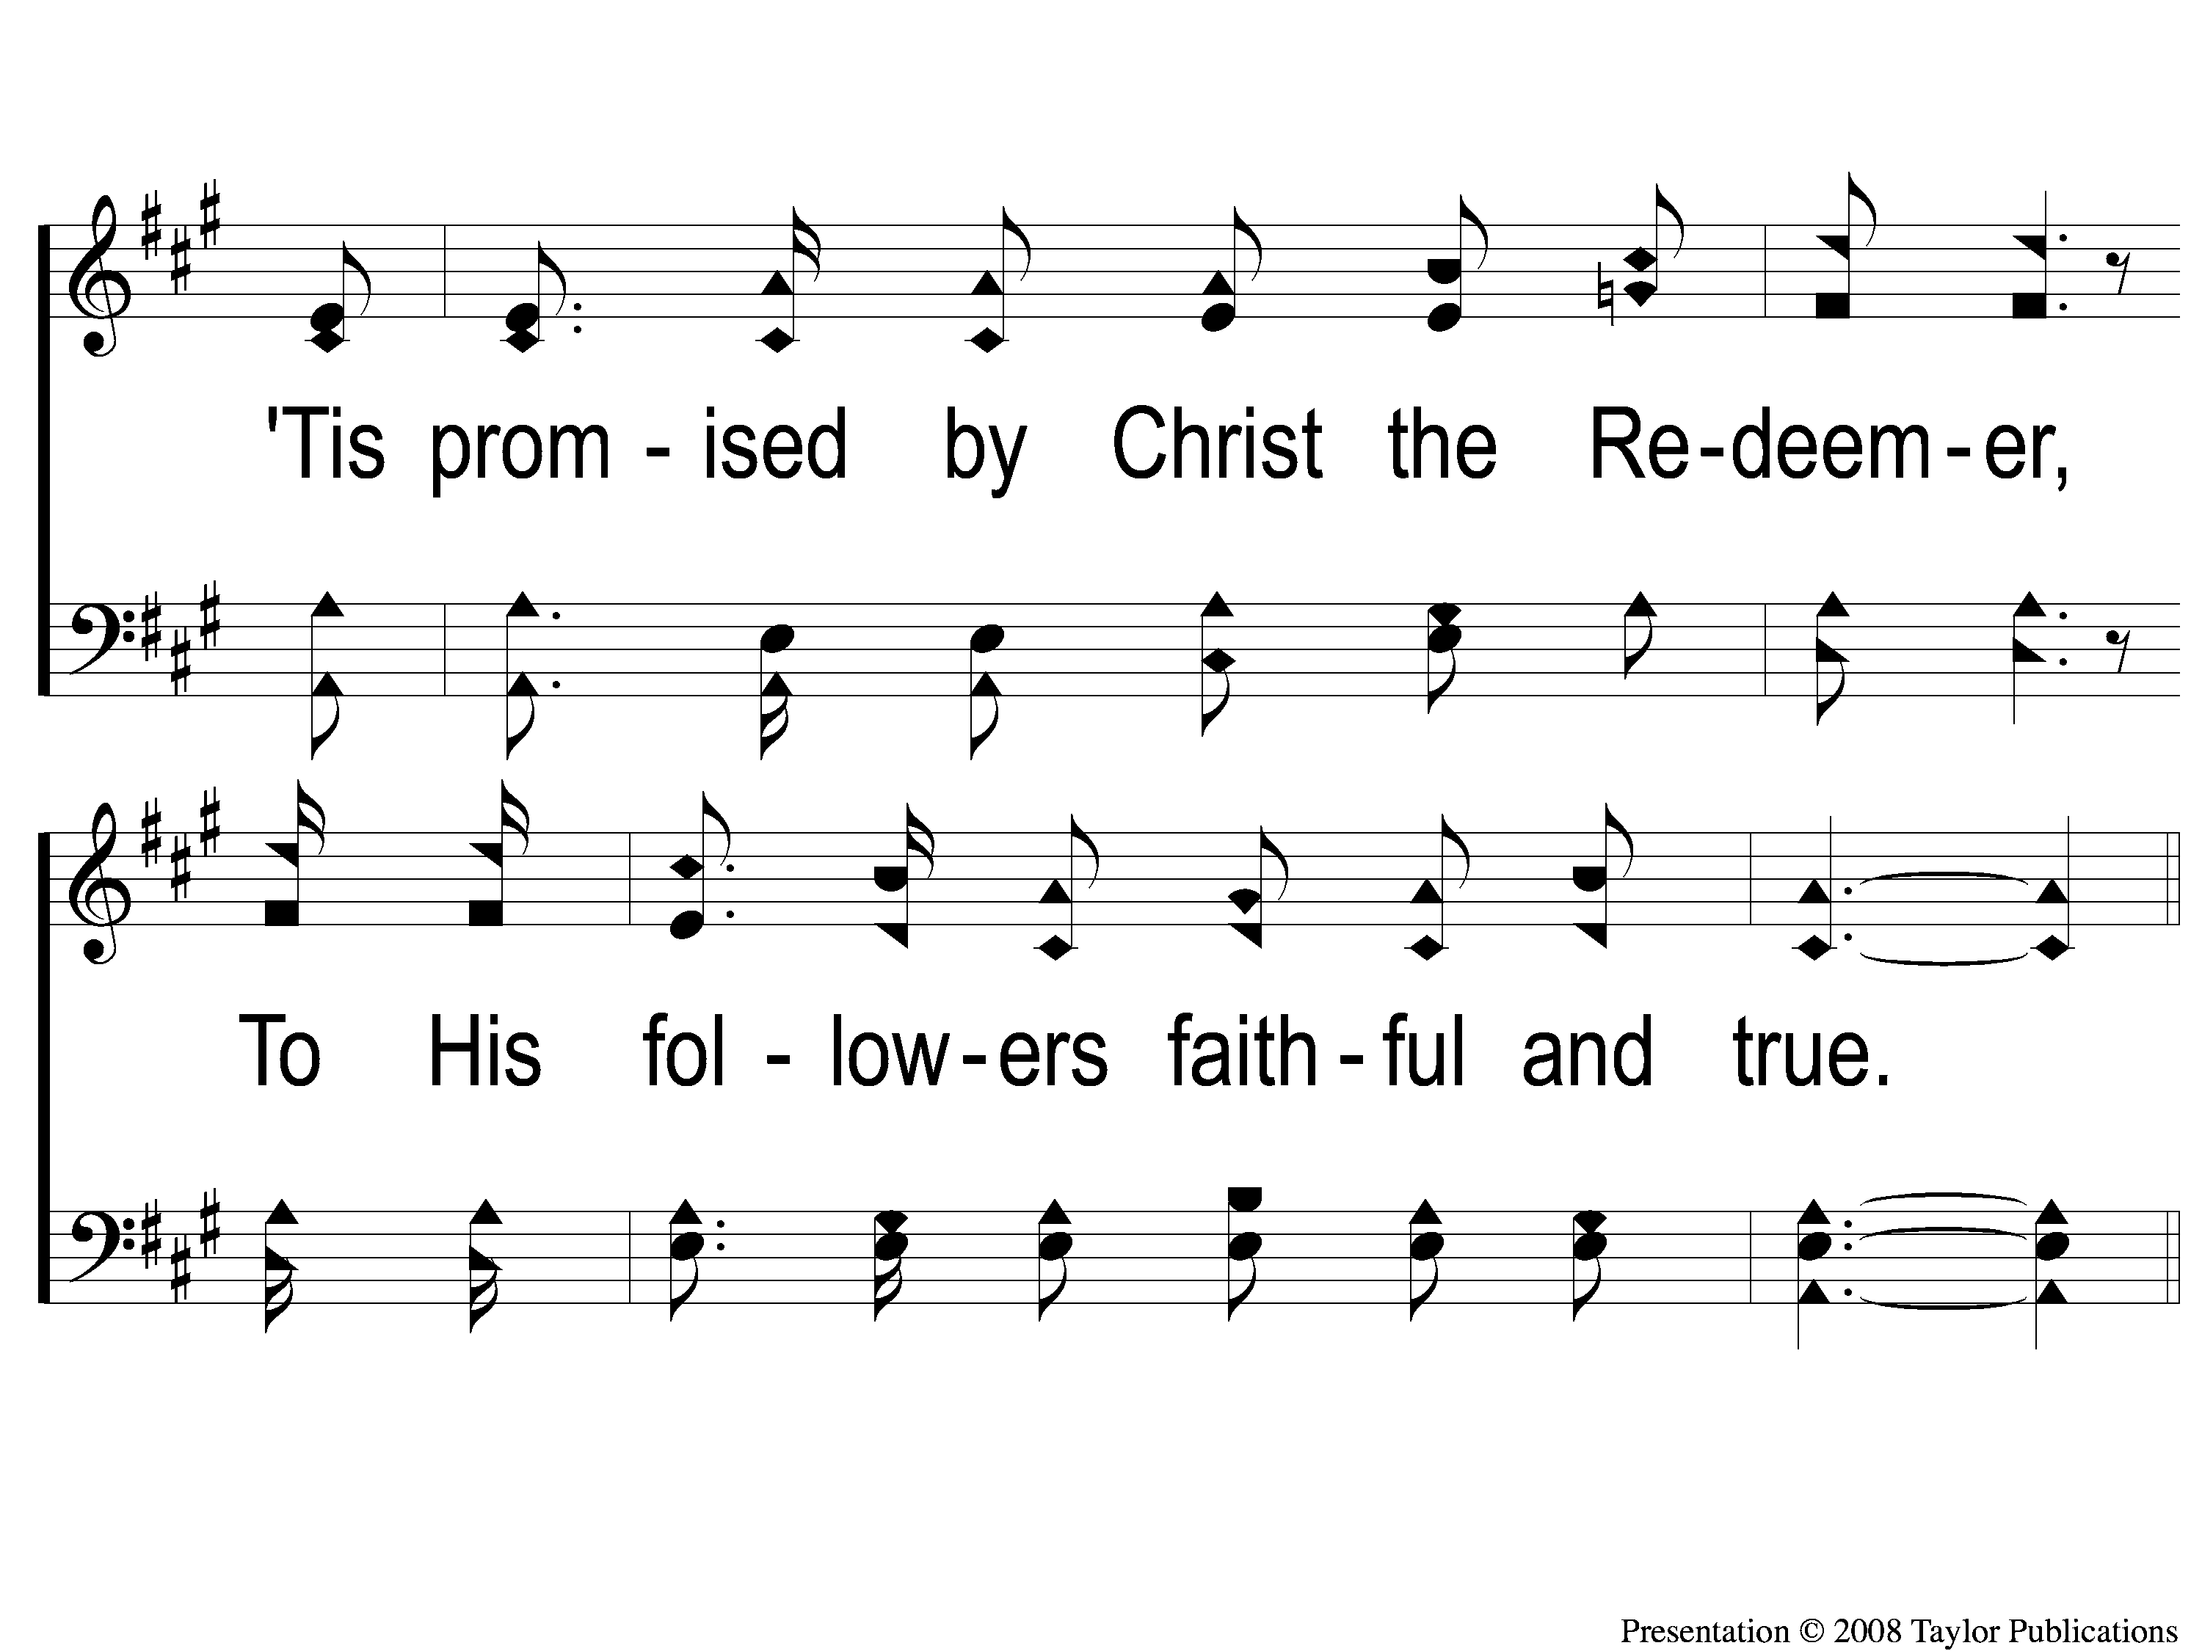
2-2 Above the Bright Blue
Above the Bright Blue
17

Slide 7
C-1 Above the Bright Blue
Above the Bright Blue
17

Slide 8
C-2 Above the Bright Blue
Above the Bright Blue
17

Slide 9
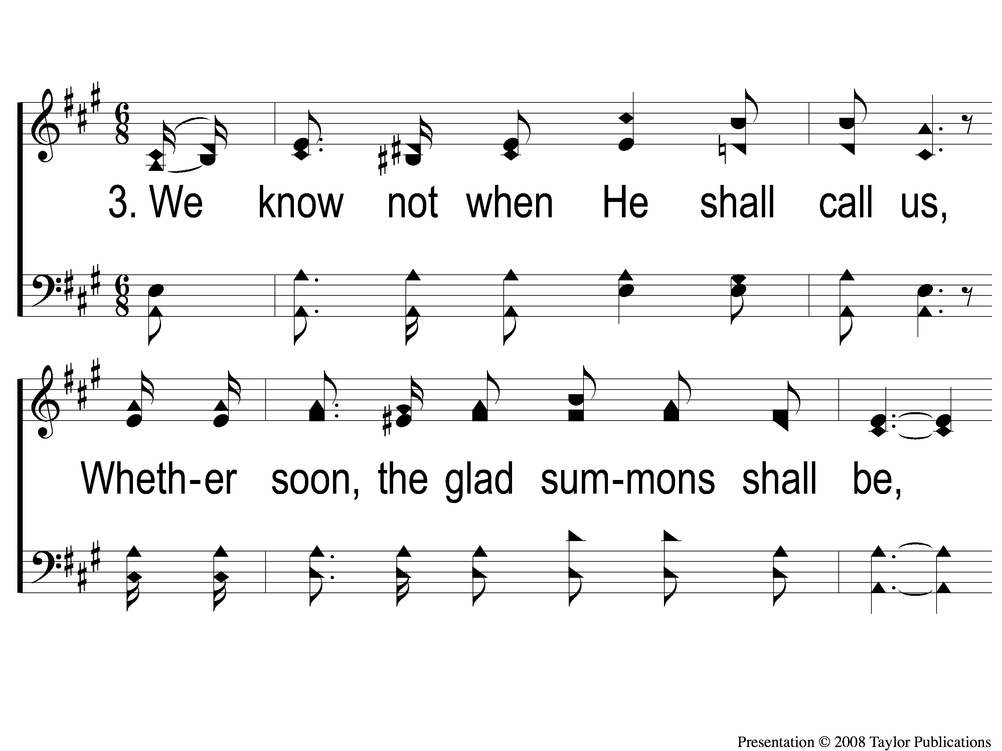
3-1 Above the Bright Blue
Above the Bright Blue
17

Slide 10
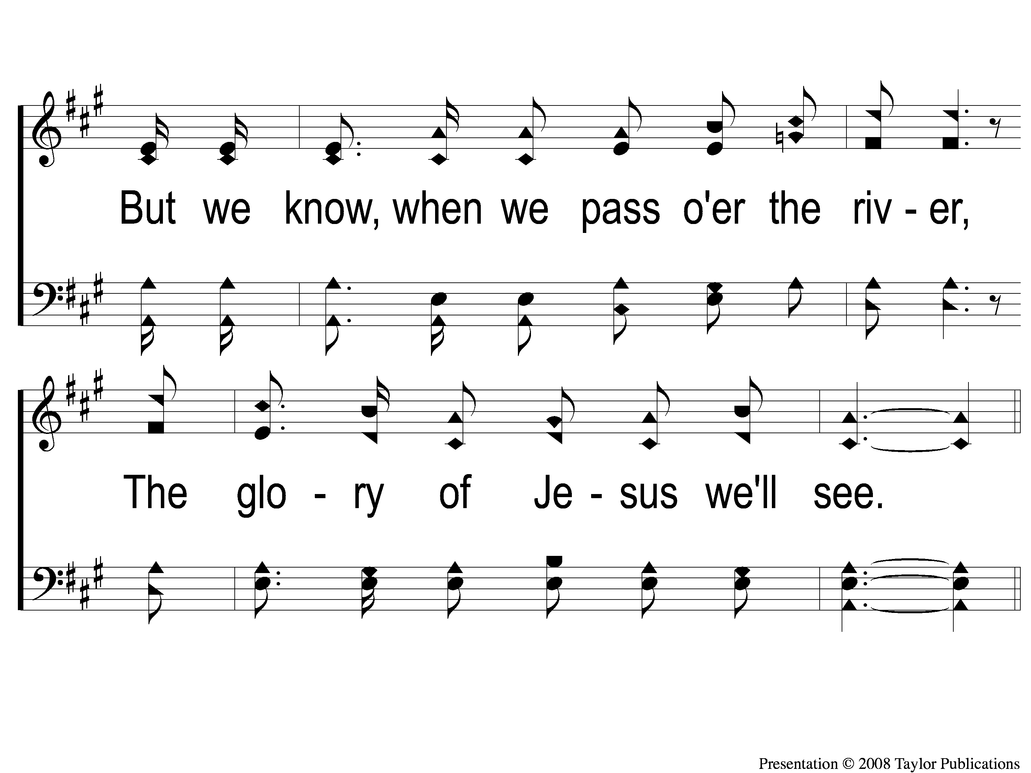
3-2 Above the Bright Blue
Above the Bright Blue
17

Slide 11
C-1 Above the Bright Blue
Above the Bright Blue
17

Slide 12
C-2 Above the Bright Blue
Above the Bright Blue
17

